Slide 1
Recognizing Critically Ill Patients
Prepared by: Mulualem Sitot (Bsc, Msc in Anesthesia)
Assistant professor, Department of Anesthesia
Addis Ababa University

Slide 2
Outline
• Goal • Objectives • Introduction • Systematic identification of critically ill patient • System by system management • Summary

Slide 3
Goal
• To provide you good working knowledge on recognition and management of critically ill patients

Slide 4
Enabling Objectives
Upon completion of this session, you will be able to:
– Recognize critically ill patients using early warning score – Assess critically ill patient systematically using ABCDE approach.
– Initiate resuscitation for critically ill patients timely and effectively

Slide 5
Introduction
What is critical illness?
Critical illness is any disease process which causes physiological instability leading to disability or death within minutes or hours.
Perturbation of the neurological and cardiorespiratory systems generally has the most immediate life-threatening effects.
Fortunately, such instability can be reliably detected by deviations from the normal range in simple clinical observations
such as level of consciousness, RR, HR, BP and urinary output.
Early recognition and appropriate measures are very crucial!

Slide 6
Introduction…
Early recognition and treatment of deteriorating patients is the key to preventing deaths.
Regular assessment of simple vital signs are essential in recognizing critical illness and helping to predict cardiorespiratory arrest.
Many hospitals use early warning systems which help to identify deteriorating patients and trigger a response.
Critically ill patients should be placed in an area with the highest supervision.

Slide 7
Introduction…
Data in 1987 indicated that up to 40% of patients in the ICUs were inappropriately admitted
either because they probably would have died regardless of the care provided
or because their illnesses were not life threatening enough to require ICU care.
“TOO Ill TO ICU and TOO WELL TO ICU ”

Slide 8
Scores to identify critically ill patients
Single Physiologic parameter score (SPAS)
Compound scores of physiological abnormality – National Early Warning score (NEWS)

Slide 9
1.Single Physiologic Parameter Score(SPAS) Update in Anaesthesia | www.anaesthesiologists.org
Physiologic parameter | Adult normal range | Triggers of critical illness
Heart rate | 50-90 | <40 >130
RR | 10-20 | <8 >30
Systolic BP | 100-140 | <90
Consciousness level | Awake, Alert | Any sudden deterioration Responds only to pain Unresponsive
Temperature | 36 oc-37.5oc | >39oc
Oxygen saturation | >95% | <90%

Slide 10
2. The National Early Warning Score (NEWS)
The NEWS is a standard clinical tool used to identify and respond to deteriorating patients
It is based on a simple scoring system using the six physiological parameters:
Respiratory rate
Oxygen saturation (SpO2) (and whether the patient needs supplemental oxygen)
Temperature
Systolic blood pressure
Pulse rate and
Level of consciousness
(using the ACVPU scale: Alert, Confusion, Voice, Pain, Unresponsive)
Notes:
The NEWS was developed by the Royal College of Physicians in 2012 to standardize the process of recording, scoring and responding to changes in routinely measured physiological parameters in acutely ill patients.

Slide 11
Why NEWS?
Early detection: identifies patients whose health is falling before they become critical
Standardization: provides a common “language” for health care workers to communicate the severity of a patient's condition.
Trends: repeated measures show whether a patient is getting better or worse over time

Slide 12
National Early Warning Score (NEWS) System…
Score | 3 | 2 | 1 |  | 0 |  | 1 | 2 | 3
Physiological parameters
RR | ≤8 |  | 9-11 | 12-20 | 12-20 |  |  | 21-24 | ≥25
Pulse | ≤40 |  | 41-50 | 51-90 | 51-90 | 91-110 | 91-110 | 111-130 | ≥131
Systolic BP | ≤90 | 91-100 | 101-110 | 111-219 | 111-219 |  |  |  | ≥220
Temperature | ≤35 |  | 35.1-36 | 36.1-38 | 36.1-38 | 38.1-39 | 38.1-39 | ≥39.1
SpO2, scale 1 (%) | ≤91 | 92-93 | 94-95 | ≥96 | ≥96
SpO2, scale 2 (%) | ≤83 | 84-85 | 86-87 | 88-92 ≥93 on air | 88-92 ≥93 on air | 93-94 on Oxygen | 93-94 on Oxygen | 95-96 on Oxygen | ≥97 on Oxygen
Air or Oxygen? |  | oxygen |  | Air | Air
Conscious level (AVPU) |  |  |  | Alert (A) | Alert (A) |  |  |  | Confusion, Reacts to voice, to pain or Unresponsive or CVPU

Slide 13
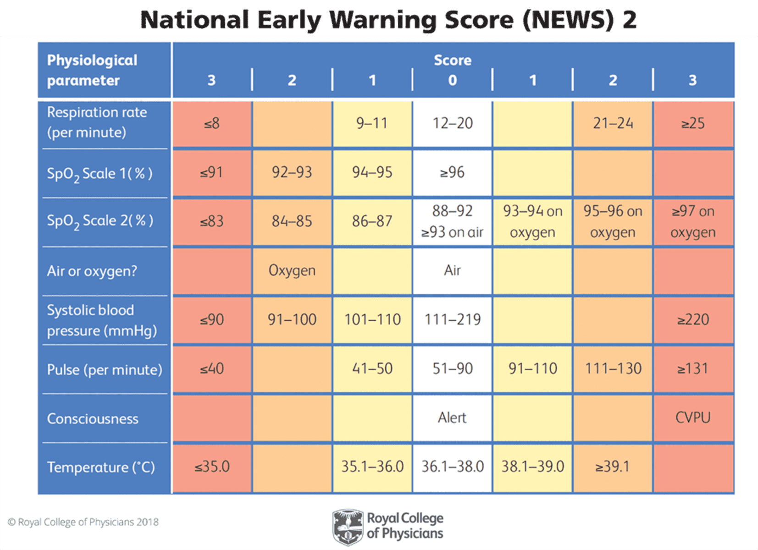
Cont.…

Slide 14
NEWS Essential Vital Signs
Risk zone in each category ranges from
Normal (0- White) to
High (3-red)
Add scores together to get the NEWS score

Slide 15
Interpreting the NEWS Score…
NEW Score | Clinical risk | Response
Score 0-4 | Low | Ward-base responses (assessment and monitoring)
Red score Score of 3 in any individual parameter | Low-Medium | Urgent ward-based response*
Score 5-6 | Medium | Key threshold for urgent response*
≥7 | High | Urgent or emergent response by a team with critical care skills**
Notes:
*Response by a clinician or team with competence in the assessment and treatment of acutely ill patients and recognizing when the escalation of care to a critical team is appropriate.
**The response team must also include staff with critical care skills, including airway managmemnt.

Slide 16
Interpreting the NEWS Score…
These triggers should determine the urgency of the clinical response, if;
A low score (NEWS score 0–4) should prompt just frequent and regular assessment
A medium score (NEWS score of 5–6) should prompt an urgent review and assessment
A high score (NEWS >7 ) should prompt emergency assessment and usually transfer of the patient to a higher dependency care area.
The threshold for critical illness is
≥5 for EWS
Notes:
These triggers should determine the urgency of the clinical response and the clinical competency of the responder/s.
A low score (NEW score 1–4) should prompt assessment by a competent registered nurse who should decide if a change to frequency of clinical monitoring or an escalation of clinical care is required.
A medium score (i.e. NEW score of 5–6 or a RED score) should prompt an urgent review by a clinician skilled with competencies in the assessment of acute illness – usually a ward-based doctor or acute team nurse, who should consider whether escalation of care to a team with critical-care skills is required (i.e. critical care outreach team).
A high score (NEW score of 7 or more) should prompt emergency assessment by a clinical team/critical care outreach team with critical-care competencies and usually transfer of the patient to a higher dependency care area.

Slide 17
Early Warning Scores (EWS)…
Example:
What is the NEWS score of a patient with a RR of 32, HR of 120, SBP 110, temperature 370c and reacts to voice?
Answer: RR of 32 =3 points, HR 120 =2 points, SBP 110 =1 point, temperature 37 0c = 0 point and conscious level =3 point.
Thus, the NEWS = 9 and the pt.is therefore critically ill.

Slide 18
Clinical approach to critically ill patients - ABCDE
The approach to critically ill patients should ALWAYS follow the ABCDE approach
–(A) Airway – (B) Breathing – (C) Circulation – (D) Disability – (E) Exposure
• Treat life-threatening problems before moving to the next step • Re-assess regularly • Recognize the need for additional help early & use a team effectively • Multiple tasks need to occur simultaneously requiring multiple people

Slide 19
ABCDE…
The ABCDE approach is intended as a rapid bedside assessment of a deteriorating/ critically ill patient, and
It is designed to provide the initial management of life-threatening conditions in order of priority,
Often one has to
quickly assess the patient,
institute life saving measures,
correct parameters and
start empiric treatment quickly, even before arriving at a definite diagnosis.

Slide 20
British Journal Of Hospital Medicine, October 2007, Vol 68, No 10
patient category Clinical observation
 | Appearance | Neurological | Respiratory | Cardiovascular
Not critically ill | Normal | Alert cooperative | Normal pattern RR >8 and <20 b/min | HR 60–100 b/min SBP > 90 mmHg UO > 0.5 ml/kg/hr
Potential critical illness | Sweaty Pale Anxious | Agitation Confusion Eyes open to voice only | Accessory muscle use RR < 8 bpm RR 20-30 bpm | HR > 100 b/min SBP <90mmhg UO < 0.5 ml/kg/hr
Critically ill | Grey Blue Mottled skin | Unresponsive or eye opens for pain only Fitting | Silent chest RR < 8 or >30 bpm Agonal respiration | HR < 50 b/min HR >150 bpm SBP <90mmhg Anuric

Slide 21
Cont…
Principles
Assess- Treat- Reassess
Structured Approach to critically ill patients
What are the steps to be followed ?
Initial Assessment
Immediate management
Monitoring
Initial Investigation

Slide 22
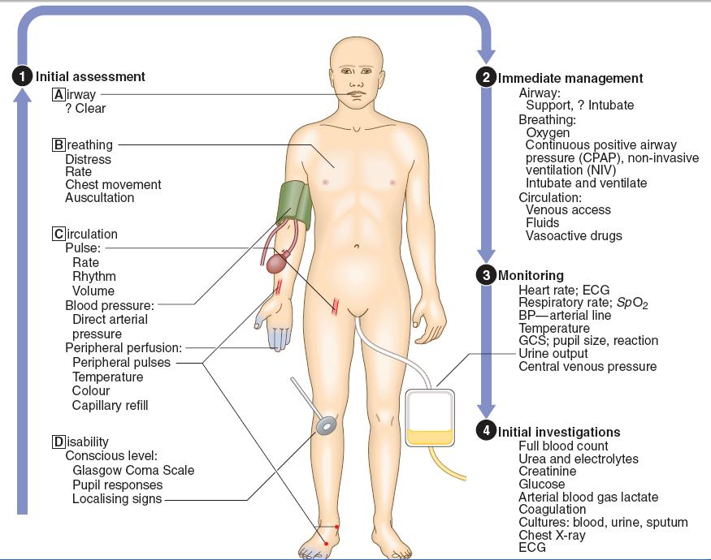
Clinical Examination Of The Critically Ill Patient

Slide 23
Initial Assessment – Identify Physiological Abnormalities
Make sure the patient is safe
Quickly assess the patient.
Do not waste time taking a detailed history; that can be done later.
Assess the clinical setting quickly:
the position the patient,
the availability of monitoring, oxygen, other resuscitation equipment, support staff, documentation etc.

Slide 24
Group work
Be in a group of 4 (A – D)
• Time allowed –
10 minutes for discussion & 5 minutes for presentation
Discuss on given part (ABCD) – How do you assess it? – What things cause abnormality to it? – What interventions (management) can be taken?

Slide 25
Assessing the patient ‐ ABCDE

Slide 26
The aim of the airway assessment is
to establish the patency of the airways and
to assess the risk of deterioration in the patient’s ability to protect their airways.

Slide 27
The patient’s airway can be;
clear (if the patient is talking),
partially obstructed (if air entry is diminished and often noisy) or
completely obstructed (if there are no breath sounds at the mouth or nose)
(Resuscitation Council 2011).

Slide 28
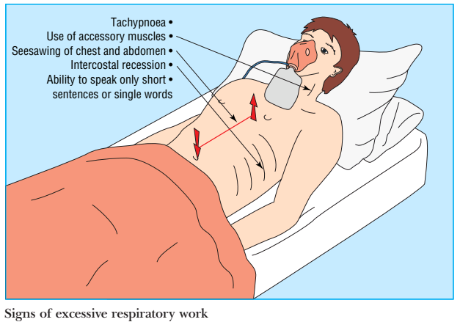

Slide 29
Airway Assessment…
Talk to the patient – is the patient responding? •If so, the airway is intact.
Is there evidence of airway obstruction (AWO)?
If so, partial or complete?
If partial AWO – Patient may complain of difficulty in breathing (if conscious) – Patient is distressed (if conscious) – Choking (if conscious) – Stridor or snoring may be present if upper airway obstruction – Wheeze may be present if lower airway obstruction
Notes:
Airway obstruction (partial or complete) can lead to cardiorespiratory arrest.
Partial airway obstruction often precedes to complete airway obstruction, which rapidly leads to cardiac arrest

Slide 30
Airway Assessment…
If complete (patient likely to be unconscious)
Respiration silent
No air movement at patient’s mouth
Respiratory movement are strenuous
“see saw” pattern of chest & abdominal movement
indrawing at sternal notch

Slide 31
Airway Assessment…
Threatened or obstructed airway
Stridor, intercostal recession
Respiratory arrest
Respiratory rate < 8 or > 35/min
Respiratory ‘distress’: use of accessory muscles
unable to speak in complete sentences
SpO2 < 90% on high-flow O2
Rising PaCO2 > 8 kPa (> 60 mmHg) or > 2 kPa (> 15 mmHg) above normal’ with acidosis

Slide 32
Causes of AWO
– CNS depression leading to loss of airway control – Face or throat trauma – Foreign body e.g., tooth / food / vomitus – Pharyngeal swelling – Epiglottitis – Laryngospasm – Bronchospasm – Bronchial secretions
Notes:
Stridor- a high-pitched breath sound resulting from turbulent air flow in the larynx or lower in the bronchial tree
Bronchospasm: spasm of bronchial smooth muscle, producing narrowing of the bronchi

Slide 33
Airway Management
If evidence of airway obstruction – act immediately & get help – Remove anything from mouth i.e. suction secretions / vomit – Airway manoeuvres (head tilt, chin lift or jaw thrust) – Use oropharyngeal airway or nasopharyngeal airway
– Supplement oxygen – Maintain patent air way
Consider need for ETTI or tracheostomy (very rarely required)

Slide 34
Airway Management…
Treat any patient with depressed LOC (GCS < 8) as at risk of AWO
• If at risk of airway obstruction but currently airway is patent: – Remove anything from mouth i.e.. suction secretions / vomit – Turn the patient into lateral position (recovery position) – Give oxygen (if necessary move the patient)

Slide 35
Breathing function should only be assessed and managed after the airway has been judged as adequate.
Assessment of breathing is designed to detect signs of respiratory distress or inadequate ventilation (Smith 2003).
Look for the general signs of respiratory distress such as
sweating,
the effort needed to breathe,
abdominal breathing and
central cyanosis.

Slide 36
Breathing…
Inspection - evidence respiratory distress? – Central cyanosis? – Noisy breathing? – Respiratory rate? A RR of over 25/min is highly suggestive of critical illness, and close monitoring is essential. – JVP? – Adequacy and equality of chest expansion? • Palpation - trachea, chest wall • Percussion • Auscultation
Auscultate the chest, check if breath sounds are equal, and listen for wheezes and crackles.
• Pulse oximetry and inspired oxygen concentration (FiO2) – Only measures oxygenation not ventilation • If available arterial blood gas analysis

Slide 37
Breathing causes
CNS depression - drugs, head injury, hypercapnia, metabolic
Poor respiratory effort
Resp. muscle weakness - spinal cord injury, high spinal block
General muscle weakness - chronic malnourishment, critical illness,
myasthenia gravis, GB syndrome
Lung pathology, Infection, PE
COPD, Lung contusion
Asthma. ARDS
Pulmonary oedema (pneumothorax)

Slide 38
Breathing management
Give oxygen (if necessary move the patient) • Treat reversible causes promptly e.g. – Antibiotics for pneumonia – Bronchodilators for asthma – Naloxone if opiate overdose – Ventilate CO2 down if hypercapnic (can do with mask) – Needle decompression for pneumothorax • Reassess patients after intervention

Slide 39

The aim of assessing the circulatory system is to determine the effectiveness of the cardiac output.
Assess patients color / temperature /-peripherally and centrally
Pulse rate and character (Pulse rate <40 or >140 bpm)
General observations e.g., responsiveness
Blood pressure-SBP <90 mmHg
Look for sources of haemorrhage including intra abdominal/intrathoracic • Assess the JVP • Auscultate the heart • Assess the urine output
Poor response to volume resuscitation
• Oliguria: <0.5 ml/kg/hr (check urea, creatinine, K+)

Slide 40
Circulation…
Causes of Poor Circulation
Possible causes include:
Shock (including hypovolaemia, septic, or anaphylactic shock)
Cardiac arrhythmias
Heart failure
Pulmonary embolism

Slide 41
Circulation management
• According to the Resuscitation Council 2011, the specific treatment for circulation problems depends on the cause, however,
fluid replacement,
restoration of tissue perfusion and
hemorrhage control will usually be necessary.

Slide 42
Circulation management…
Give oxygen • Insert 1 or more large bore IV cannula (14G/ 16G/18 G) • Treat the cause - If hypovolaemia; rapid fluid challenge 500 mL - 1L over 5 to 10 min. - If cardiac failure and hypotensive; more cautious fluid challenge with careful monitoring • Reassess (every 5 mins) • If no improvement – repeat fluid challenge • If signs of pulmonary oedema – slow or stop fluids and consider inotrope

Slide 43
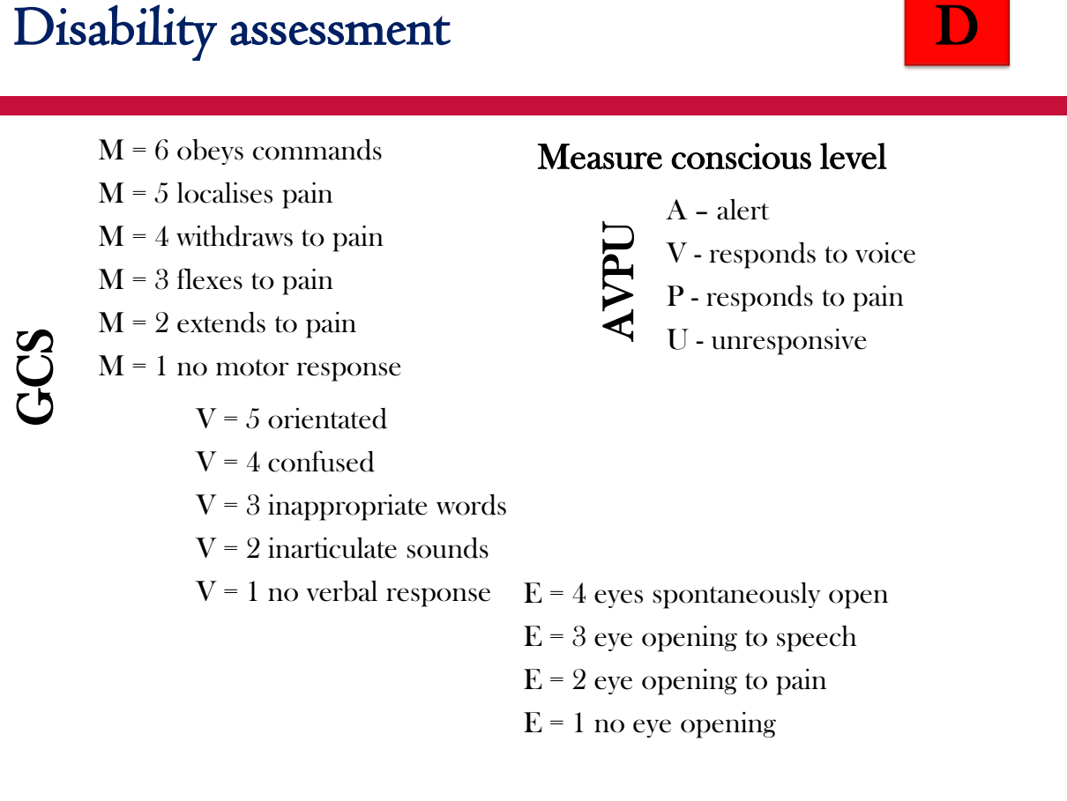
Notes:
GCS score provides a standard means of evaluating the patient's neurologic status. When compared to the Glasgow Coma Scale (GCS), the AVPU classification of alertness has been suggested to correspond in the following manner:
Alert = 15 GCS
Voice Responsive = 12 GCS
Pain Responsive = 8 GCS
Unconscious = 3 GCS
MOTOR- -3 =Decorticate posturing (upper extremity flexion)
Motor 2- Decerebrate posturing (upper extremity extension)

Slide 44
Examine for signs of head injury
Examine pupils – size, equality, light reaction
Check drug chart / collateral history - ? drug induced depressed LOC • Check blood glucose
GCS ≤8 = deep coma, severe head trauma, poor outcome.
GCS 9–12 = conscious patient with moderate injury.
GCS >12 = mild injury.

Slide 45
Disability causes
Causes of reduced consciousness – Hypoxia – Hypercapnia – Hypotension – Hypoglycaemia – Raised ICP – haematoma / ICSOL – Drug induced – Severe electrolyte disturbances (e.g. Na+) – Epilepsy

Slide 46
Disability Management
Treat the cause (where possible) – Hypoxia – Hypercapnia – Hypotension – Hypoglycaemia – glucose 50mls of 10% dextrose – Head injury – inform surgeons – Drug induced – give antagonist where appropriate e.g. naloxone
Supportive treatment may be the only option, the aim being to maintain the ABC. • Giving the patient time to recover from the insult and to prevent secondary brain injury

Slide 47
Treatment of altered conscious level
The priority is to assess airway, breathing and circulation to exclude hypoxia and hypotension.
Check the patient’s medicine chart for reversible medicine-induced causes of an altered level of consciousness, and remember to call for expert help (Thim T et al. 2012).
Unconscious patients whose airways are not protected should be nursed in the lateral position (Resuscitation Council 2011).

Slide 48
By the time the assessment reaches this stage (exposure), there should be a good understanding of the patient’s problems (Mallet 2013).
Conduct a thorough examination of the patient’s body for abnormalities,
checking the patient’s skin for the presence of rashes, swelling, bleeding or any excessive losses from drains.
Examine and expose the patient fully whilst trying to minimise heat loss.
But respect the patient’s dignity at all times!
Treat any relevant finding appropriately

Slide 49
Summary
Early recognition and effective treatment of critically ill patients is key to prevent cardiac arrests and death
The ABCDE approach is a robust clinical tool that enables healthcare professionals to determine the seriousness of the patient’s condition and prioritize clinical interventions.
NEWS chart is very helpful to determine the urgency of the clinical response

Slide 50
References
Resuscitation Council 2011
British Journal of Hospital Medicine, October 2007, Vol 68, No.10
Update in Anesthesia

Slide 51
?

